Slide 1

Building a Local Book Recommendation Agent with LangGraph
Simplicity, Control, and Local Inference.

Slide 2

Project Overview
Goal
Create a simple agent capable of running on local inference.
Why Local?
Test case for agent with no external API calls (excl. Web
Experiment with local processing (Ollama's LLaMA 3)
Path
Smolagents -> no framework -> LangGraph
Challenges
JSON-parsing, “Why is the agent doing what it does?”, Hugging Face implementation.

Slide 3




Simplifying the Architecture
SmolAgents
Command Sequence
LangGraph
Too complex & unpredictable.
Predictable but not easily scalable.
Flexible, controlled flow.
LangGraph provides a flexible control flow for building complex agent workflows.

Slide 4
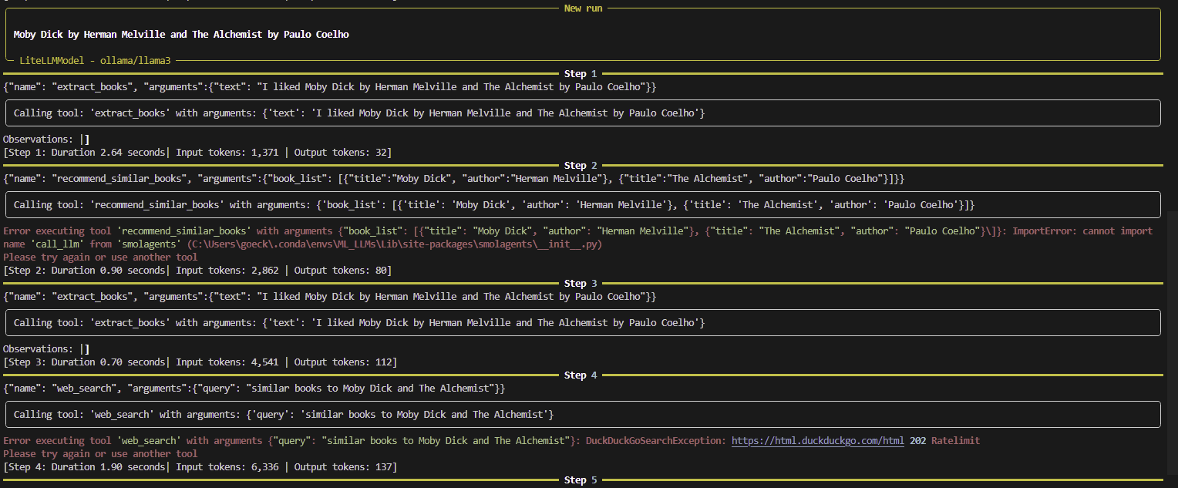
Initial Approach: SmolAgents
Multi-step agent with poor control
Complex, unpredictable behavior
SmolAgents showed promise in data extraction but lacked the flow control and transparency needed for reliable book recommendations.
Notes:
I liked the organized yellow framework.
But the steps taken were unpredictable.

Slide 5

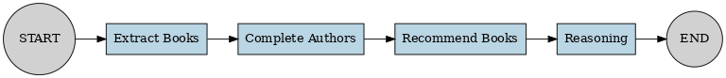
Final Architecture (LangGraph)
Built with LangGraph StateGraph for clear flow and Gradio app for simple UI interaction.
Extract Books
LLM parses titles/authors from user input + completes missing authors.
Recommend Books
DuckDuckGo search (as a test case and to get always up-to-date results &
work with up-to-date inputs).
Reason About Recommendations
LLM consolidates results.
Notes:
Web search also to be able to use a very simple LLM

Slide 6
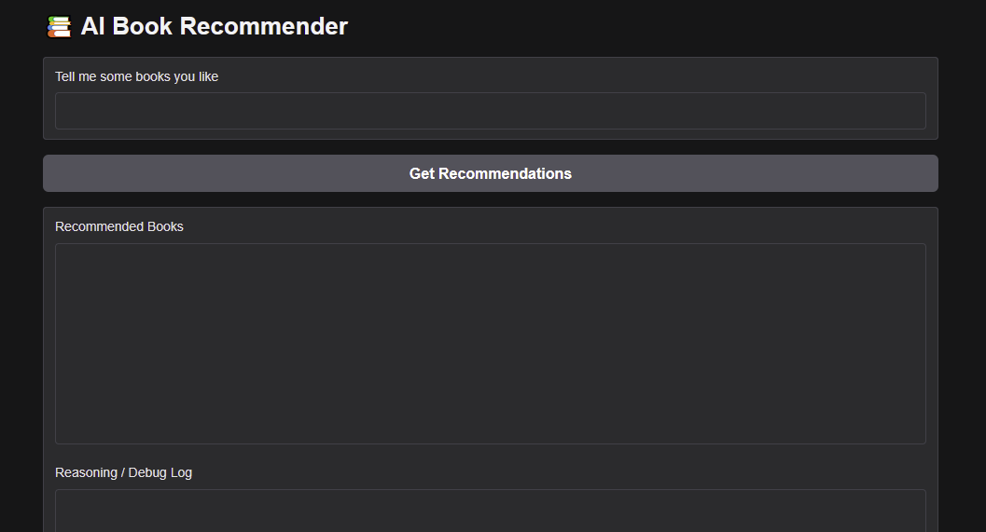
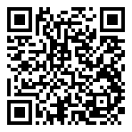
UI & Demo
https://huggingface.co/spaces/Lui3ui3ui/BookRecommender
The Hugging Face Demo runs on:
Mistral-7B-Instruct-v0.2
A simple UI for users to input their preferences and receive book recommendations.

Slide 7
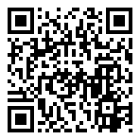
UI & Demo
https://huggingface.co/spaces/Lui3ui3ui/BookRecommender
https://github.com/tomato-user2/agent-project
The Hugging Face Demo runs on:
Mistral-7B-Instruct-v0.2
A simple UI for users to input their preferences and receive book recommendations.

Slide 8
Challenges
JSON parsing errors (!)
Adapting local setup to HF Inference
Understanding the actions of the agent (mostly debugging/logging)
Deploying to Hugging Face Spaces presented challenges in adapting the local Ollama setup, currently running on CPU.
Notes:
LangGraph initial setup had no logging in comparison to smolagents logging as seen on slide 4

Slide 9




Lessons Learned:
Goals Achieved:
Simplify Tasks
Simple local inference possible
Break complex tasks into smaller, sequential steps.
Runs on small laptop
Insights about agentic workflows
Control Pipeline
Got to work with and learn about different frameworks
Control the pipeline with clear state transitions.
Improvements:
Make it output a specified number of recommendations
Transparent Logging
Make sure the input books are not mentioned
Key to understanding agent reasoning.

Slide 10
Outlook: Towards the OfficeBot
Easy
Medium
File structure recognition + document sorting
Reasoning follow-ups from document context
Hard
Hard
Enabling the agent to perform follow-ups
Extract the correct data from documents to sort them correctly
Notes:
Show starting space on HF?

Slide 11
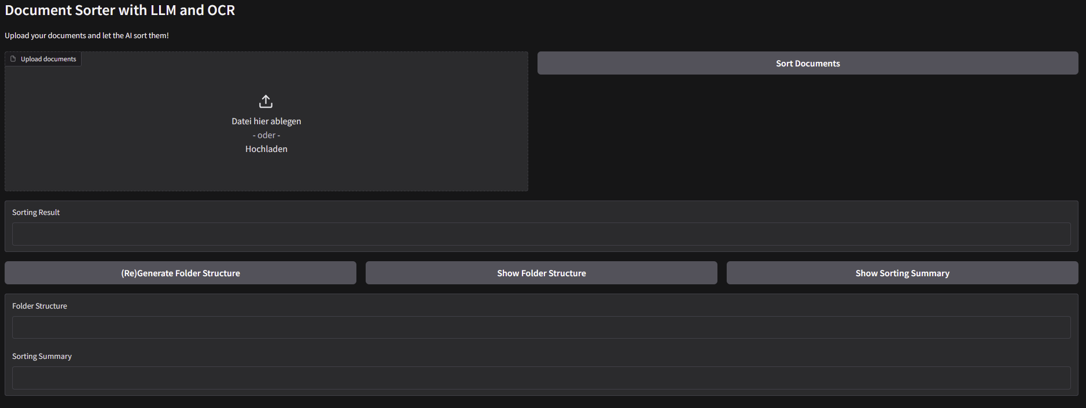
Outlook: Towards the OfficeBot
Notes:
Show starting space on HF?

Slide 12
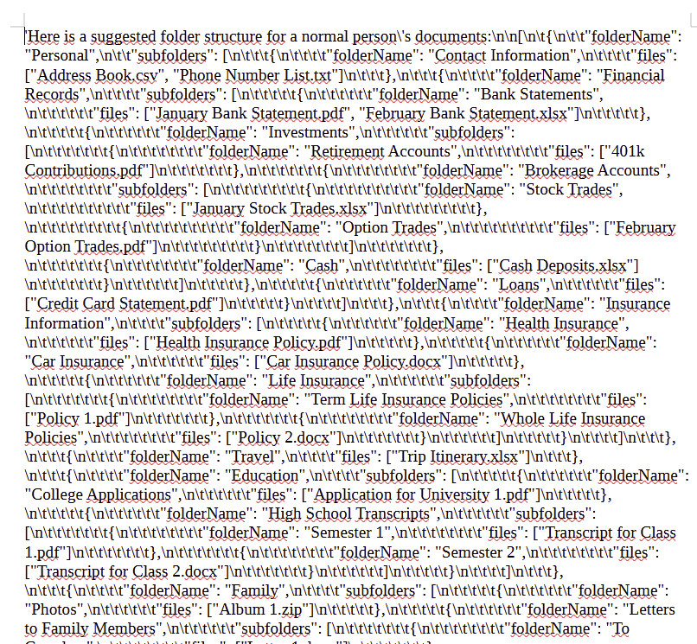
Outlook: Towards the OfficeBot
Notes:
Show starting space on HF?

Slide 13
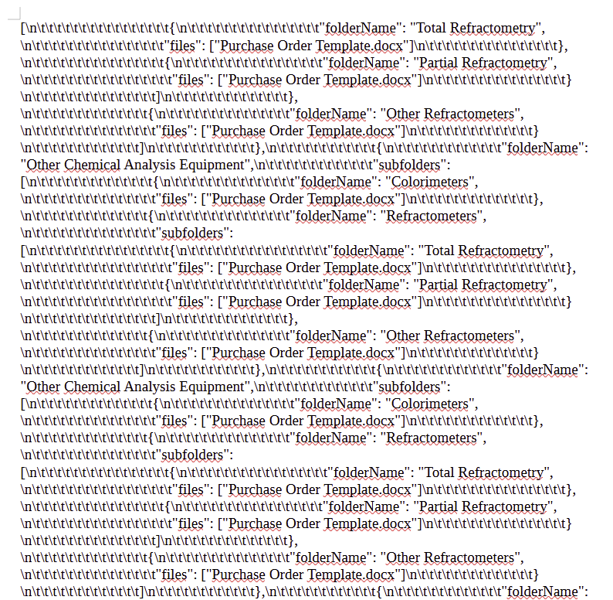
Outlook: Towards the OfficeBot
20 Pages
Notes:
Show starting space on HF?

